Slide 1
Management Decision Support System for Travelling Salesman Problem (MDSS-TSP)

Slide 2
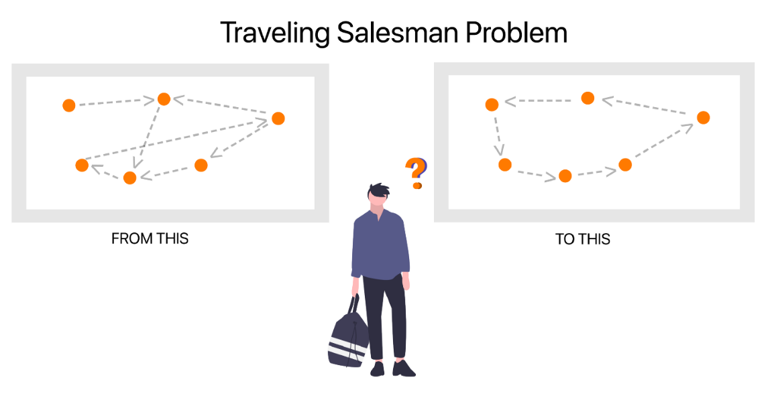
What is Traveling Salesman Problem
Given Premises:
a set of cities (or nodes of a graph) and
the distance / time / cost for each pair of cities (or edges of a graph)
Given Constraints
Visit every city exactly once and return to the starting point.
Problem:
Find the least distance / time / cost path to traverse the graph

Slide 3
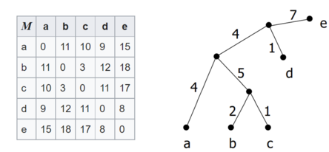
Requirements For ANY TSP
Data Matrix, where matrix[i][j] holds the cost of traveling form city “i” to city “j”.
Algorithm to solve TSP. Different algorithms can be used based on a managers requirements, this fundamentally constitutes the Decision Support System (DSS).
Distance Matrix

Slide 4
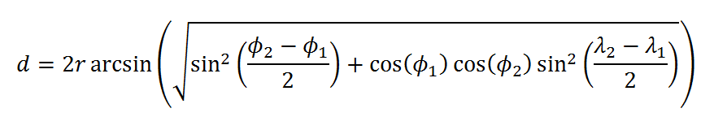
Finding Values For Distance Matrix
The distributor inputs the latitudes and longitudes of a pair of outlets in the program in case he does not have the traveling cost between two outlets, and calculates the haversine distance between the two.

Slide 5
Decision Support System (DSS) Overview
DSS
Our DSS will make use of multiple mathematical methods such as
Enumeration Method
Branch and Bound
Hungarian Assignment Method
Nearest Neighbour Method
Other methods can also be used, like Modified Transport Allocation Algorithms:
Initial Feasible Solution with Row Minima, Column Minima, Vogels Approximation and U-V Method, Stepping Stone Optimality Test
Feasible solutions will be output by the DSS
Enumeration Method
Branch and Bound Method
Hungarian Method
Nearest Neighbour Method

Slide 6
Putting All The Pieces Together
DSS
Enumeration Method
DATA MATRIX
(Obtained using API’s and Haversine Formula)
Branch and Bound Method
FEASIBLE SOLUTION / NEAR OPTIMAL SOLUTION
DISTRIBUTOR
CONSTRAINTS
Hungarian Method
Nearest Neighbour Method
WHAT-IF ANALYSIS
VALIDATE SOLUTION
(Using cplex Libraries)

Slide 7

GETTING STARTED

Slide 8

STEP 1: Installing Python v3
First, visit the official Python website (www.python.org)
In the Downloads section, select the latest version of Python 3 and download it. Once downloaded double-click on the installer.
As shown in the image, check both the boxes and 'Install Now'.

Slide 9

STEP 2: Select IDE
An IDE is a place where we write Python code. For this tutorial, I will be using VS Code.
From (https://code.visualstudio.com/), download and install VS Code with default settings
On the main screen, hit 'Ctrl + Shift + X' to open the marketplace.
Type 'Python' and install the extension published by Microsoft.
Go back to the explorer using 'Ctrl + Shift + E' and create a new folder where you can store the code we write.
In this folder, create a new file with a .py extension.
At the bottom left corner, select the recommended python environment. (As shown in image).
You are now good to go!

Slide 10
METHOD 1: BRUTE FORCE

Slide 11
STEPS TO SOLVE
Using the following steps, we can obtain all possible paths from the starting node to every vertex (once) and back to the starting node.
Cost of each cycle is stored, and the 'minimum-cost' path is found and selected.
For this approach, we write code in Python.

Slide 12
Algorithm

Slide 13
Defining the Data Matrix
 | 1 | 2 | 3 | 4 | 5
1 | - | 7 | 5 | 3 | 5
2 | 7 | - | 8 | 4 | 3
3 | 7 | 8 | - | 6 | 2
4 | 3 | 4 | 6 | - | 2
5 | 5 | 3 | 2 | 2 | -
Create a data matrix which contains distance / time / cost between each pair of nodes. The dimensions of the matrix are n x n, where n is the number of nodes in the graph.
In Python, we create nested lists.

Slide 14
STEP: Creating a Recursive Function To Find and Store All Paths and Corresponding Costs
INPUTS:
node_set: list containing unvisited vertices
start_node: vertex from which we would like searching for paths
previous_node: previous vertex visited
current_node: current vertex being visited
path: list containing the path traversed up to the current node
paths: list containing the complete path from starting node to each vertex once and back
cost: aggregate cost of the path traversed up to the current node
costs: list containing the aggregate cost of the complete path from starting node to each vertex once and back

Slide 15
Continued...
Initial parameters passed to invoke the function are as follows:
node_set = [0,1,2,3,4]
start_node = current_node = previous_node = 0
path = paths = [ ]
cost = costs = 0

Slide 16
Continued...
For each call of the function,
I) Append current_node to path
II) Add the cost of traversing from previous_node to current_node from the data matrix to the cost variable.
III) Set previous_node as the current node
IV) Remove the current_node from the node_set (marking it visited)
V) For remaining nodes in node_set, call the function again with each node in node_set as current_node. Also, note how we create a copy of the node_set and path in a new variable to pass it 'by value' and not 'by reference'.

Slide 17
Continued...
The first call of the function is slightly different from the successive calls!
In the first call, previous_node == current_node,
We only follow steps I), IV) and V).

Slide 18
Continued...
BASE CASE: if node_set is empty, we perform a few operations before terminating the recursive calls.
Append the start_node at the end of the path
Add the cost of traversing from the previous_node to the start_node to the cost variable
Append the path list to paths list
Append the cost variable to the costs list
Return

Slide 19
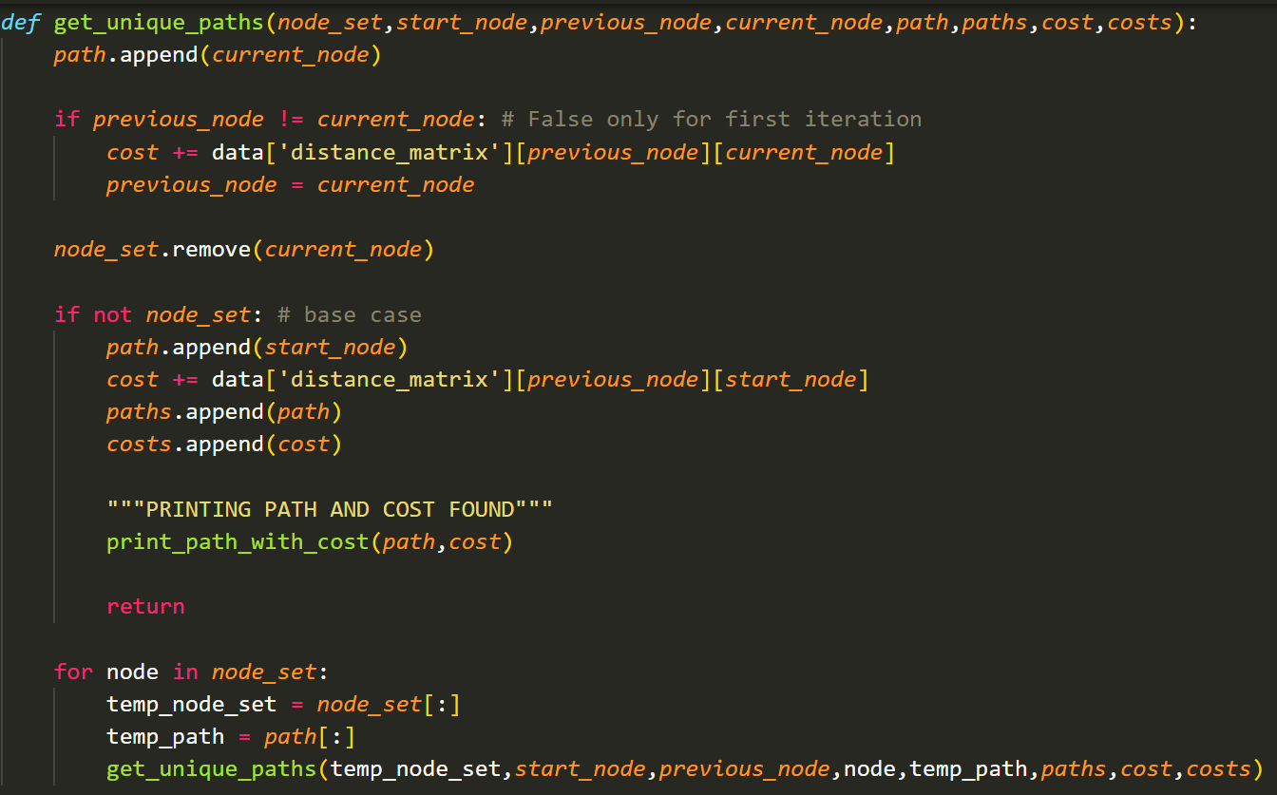
Continued...
Code for reference...
About the code:
Time complexity is of the order O(n!)
Printing the path and corresponding cost is optional and can be done with the help of a function.

Slide 20
ILLUSTRATION

Slide 21
 | 1 | 2 | 3 | 4 | 5
1 | - | 7 | 5 | 3 | 5
2 | 7 | - | 8 | 4 | 3
3 | 7 | 8 | - | 6 | 2
4 | 3 | 4 | 6 | - | 2
5 | 5 | 3 | 2 | 2 | -
 | 1 | 2 | 3 | 4 | 5
1 | - | 7 | 5 | 3 | 5
2 | 7 | - | 8 | 4 | 3
3 | 7 | 8 | - | 6 | 2
4 | 3 | 4 | 6 | - | 2
5 | 5 | 3 | 2 | 2 | -
 | 1 | 2 | 3 | 4 | 5
1 | - | 7 | 5 | 3 | 5
2 | 7 | - | 8 | 4 | 3
3 | 7 | 8 | - | 6 | 2
4 | 3 | 4 | 6 | - | 2
5 | 5 | 3 | 2 | 2 | -
 | 1 | 2 | 3 | 4 | 5
1 | - | 7 | 5 | 3 | 5
2 | 7 | - | 8 | 4 | 3
3 | 7 | 8 | - | 6 | 2
4 | 3 | 4 | 6 | - | 2
5 | 5 | 3 | 2 | 2 | -
Cost = 28
Cost = 22
Cost = 24
Cost = 22
 | 1 | 2 | 3 | 4 | 5
1 | - | 7 | 5 | 3 | 5
2 | 7 | - | 8 | 4 | 3
3 | 7 | 8 | - | 6 | 2
4 | 3 | 4 | 6 | - | 2
5 | 5 | 3 | 2 | 2 | -
 | 1 | 2 | 3 | 4 | 5
1 | - | 7 | 5 | 3 | 5
2 | 7 | - | 8 | 4 | 3
3 | 7 | 8 | - | 6 | 2
4 | 3 | 4 | 6 | - | 2
5 | 5 | 3 | 2 | 2 | -
 | 1 | 2 | 3 | 4 | 5
1 | - | 7 | 5 | 3 | 5
2 | 7 | - | 8 | 4 | 3
3 | 7 | 8 | - | 6 | 2
4 | 3 | 4 | 6 | - | 2
5 | 5 | 3 | 2 | 2 | -
 | 1 | 2 | 3 | 4 | 5
1 | - | 7 | 5 | 3 | 5
2 | 7 | - | 8 | 4 | 3
3 | 7 | 8 | - | 6 | 2
4 | 3 | 4 | 6 | - | 2
5 | 5 | 3 | 2 | 2 | -
Cost = 21
Cost = 25
Cost = 24
Cost = 21

Slide 22
 | 1 | 2 | 3 | 4 | 5
1 | - | 7 | 5 | 3 | 5
2 | 7 | - | 8 | 4 | 3
3 | 7 | 8 | - | 6 | 2
4 | 3 | 4 | 6 | - | 2
5 | 5 | 3 | 2 | 2 | -
 | 1 | 2 | 3 | 4 | 5
1 | - | 7 | 5 | 3 | 5
2 | 7 | - | 8 | 4 | 3
3 | 7 | 8 | - | 6 | 2
4 | 3 | 4 | 6 | - | 2
5 | 5 | 3 | 2 | 2 | -
 | 1 | 2 | 3 | 4 | 5
1 | - | 7 | 5 | 3 | 5
2 | 7 | - | 8 | 4 | 3
3 | 7 | 8 | - | 6 | 2
4 | 3 | 4 | 6 | - | 2
5 | 5 | 3 | 2 | 2 | -
 | 1 | 2 | 3 | 4 | 5
1 | - | 7 | 5 | 3 | 5
2 | 7 | - | 8 | 4 | 3
3 | 7 | 8 | - | 6 | 2
4 | 3 | 4 | 6 | - | 2
5 | 5 | 3 | 2 | 2 | -
Cost = 23
Cost = 23
Cost = 17
Cost = 20
 | 1 | 2 | 3 | 4 | 5
1 | - | 7 | 5 | 3 | 5
2 | 7 | - | 8 | 4 | 3
3 | 7 | 8 | - | 6 | 2
4 | 3 | 4 | 6 | - | 2
5 | 5 | 3 | 2 | 2 | -
 | 1 | 2 | 3 | 4 | 5
1 | - | 7 | 5 | 3 | 5
2 | 7 | - | 8 | 4 | 3
3 | 7 | 8 | - | 6 | 2
4 | 3 | 4 | 6 | - | 2
5 | 5 | 3 | 2 | 2 | -
 | 1 | 2 | 3 | 4 | 5
1 | - | 7 | 5 | 3 | 5
2 | 7 | - | 8 | 4 | 3
3 | 7 | 8 | - | 6 | 2
4 | 3 | 4 | 6 | - | 2
5 | 5 | 3 | 2 | 2 | -
 | 1 | 2 | 3 | 4 | 5
1 | - | 7 | 5 | 3 | 5
2 | 7 | - | 8 | 4 | 3
3 | 7 | 8 | - | 6 | 2
4 | 3 | 4 | 6 | - | 2
5 | 5 | 3 | 2 | 2 | -
Cost = 22
Cost = 19
Cost = 25
Cost = 21

Slide 23
 | 1 | 2 | 3 | 4 | 5
1 | - | 7 | 5 | 3 | 5
2 | 7 | - | 8 | 4 | 3
3 | 7 | 8 | - | 6 | 2
4 | 3 | 4 | 6 | - | 2
5 | 5 | 3 | 2 | 2 | -
 | 1 | 2 | 3 | 4 | 5
1 | - | 7 | 5 | 3 | 5
2 | 7 | - | 8 | 4 | 3
3 | 7 | 8 | - | 6 | 2
4 | 3 | 4 | 6 | - | 2
5 | 5 | 3 | 2 | 2 | -
 | 1 | 2 | 3 | 4 | 5
1 | - | 7 | 5 | 3 | 5
2 | 7 | - | 8 | 4 | 3
3 | 7 | 8 | - | 6 | 2
4 | 3 | 4 | 6 | - | 2
5 | 5 | 3 | 2 | 2 | -
 | 1 | 2 | 3 | 4 | 5
1 | - | 7 | 5 | 3 | 5
2 | 7 | - | 8 | 4 | 3
3 | 7 | 8 | - | 6 | 2
4 | 3 | 4 | 6 | - | 2
5 | 5 | 3 | 2 | 2 | -
Cost = 23
Cost = 22
Cost = 25
Cost = 25
 | 1 | 2 | 3 | 4 | 5
1 | - | 7 | 5 | 3 | 5
2 | 7 | - | 8 | 4 | 3
3 | 7 | 8 | - | 6 | 2
4 | 3 | 4 | 6 | - | 2
5 | 5 | 3 | 2 | 2 | -
 | 1 | 2 | 3 | 4 | 5
1 | - | 7 | 5 | 3 | 5
2 | 7 | - | 8 | 4 | 3
3 | 7 | 8 | - | 6 | 2
4 | 3 | 4 | 6 | - | 2
5 | 5 | 3 | 2 | 2 | -
 | 1 | 2 | 3 | 4 | 5
1 | - | 7 | 5 | 3 | 5
2 | 7 | - | 8 | 4 | 3
3 | 7 | 8 | - | 6 | 2
4 | 3 | 4 | 6 | - | 2
5 | 5 | 3 | 2 | 2 | -
 | 1 | 2 | 3 | 4 | 5
1 | - | 7 | 5 | 3 | 5
2 | 7 | - | 8 | 4 | 3
3 | 7 | 8 | - | 6 | 2
4 | 3 | 4 | 6 | - | 2
5 | 5 | 3 | 2 | 2 | -
Cost = 22
Cost = 24
Cost = 26
Cost = 28

Slide 24
DISPLAY OPTIMUM SOLUTION
 | 1 | 2 | 3 | 4 | 5
1 | - | 7 | 5 | 3 | 5
2 | 7 | - | 8 | 4 | 3
3 | 7 | 8 | - | 6 | 2
4 | 3 | 4 | 6 | - | 2
5 | 5 | 3 | 2 | 2 | -
As we can see from the above illustration, the minimum cost achieved is 17 (index can be found using 'min' function in Python)
The path that follows it is 1 -> 3 -> 5 -> 2 -> 4 -> 1
Compile time for a 10x10 matrix = 0.8125s

Slide 25
METHOD 2: BRANCH AND BOUND

Slide 26
ALGORITHM

Slide 27
STEP1: CREATE DATA MATRIX
 | 1 | 2 | 3 | 4 | 5
1 | ∞ | 0 | 20 | 30 | 11
2 | 15 | ∞ | 16 | 4 | 2
3 | 3 | 5 | ∞ | 2 | 4
4 | 19 | 6 | 18 | ∞ | 3
5 | 16 | 4 | 7 | 16 | ∞
Create a data matrix which contains distance / time / cost between each pair of nodes. The dimensions of the matrix are n x n, where n is the number of nodes in the graph.
In Python, we create nested lists.
We set the forward diagonal values to infinity to prevent looping over the same city

Slide 28
STEP 2: CREATE A DATA STRUCTURE FOR A STATES BASED TREE
VARIABLES:
data_matrix –(nested list) of the matrix created for the particular node
cost – (integer) aggregate cost of traversing from the root to the current node
parent – (self) stores the parent node
level – (integer) level of the node in the states based tree
children – (list) contains child nodes (self)
ancestors – (list) path of nodes from root to current node
leaf_nodes – (list) a class variable storing leaf nodes

Slide 29
METHODS
__init__ (self,data_matrix,cost,parent,level,city):
We assign values to the class data
add_child(self,node):
Append the passed child node to self.children
add_ancestor(self,parent_node):
Append parent node ancestors and parent node to self.ancestors
show_data(self):
Print all the data values stored in a node
add_leaf_node(self):
Add current node to a class variable list called leaf_nodes
remove_leaf_nodes(self):
Remove current node from leaf_nodes class variable
show_leaves(self):
A class method to print the class variable, leaf_nodes

Slide 30
STEP 3: DEFINE OTHER USEFUL FUNCTIONS
matrix_lower_bound(matrix):
Performs row and column transformations on the matrix.
Row Transformation: subtract the minimum row value from each value in the corresponding row
Column Transformation: subtract the minimum column value from each value in the corresponding column
Returns the sum of minimum values subtracted from each row and each column.
data_matrix_value(from_node,to_city):
In from_node.data_matrix, cover from_node.city th row, to_city th column and from_node.data_matrix[to_city][0] with infinity
Return the covered data_matrix and the value of the data matrix = from_node.cost + from_node.data_matrix[from_node.city][to_city] + matrix_lower_bound(data_matrix)
print_path_with_cost(path,cost):
Takes in a list of the optimal path and the cost associated with it and displays the output in readable format.

Slide 31
STEP 4: FUNCTIONS USED TO SOLVE
update_upper_bound():
This method is responsible to update the upper bound (initially set to infinity) and return the path followed to find this upper bound.
An initial states based tree is also created, who’s leaf nodes are later explored if required.
HOW DOES THIS METHOD WORK?
Starting from the root node, the remaining n-1 nodes are taken pairwise to find the exploration cost of each node from the root node. The node having the least cost is selected and similar exploration is performed further till only one node is left.
The nodes which aren’t least cost nodes are leaf nodes.
The cost obtained at the last node explored is the new upper bound used as a bounding function.
A simple for loop is used.

Slide 32
explore(current_node,unvisited_node_set,paths,costs,visited_leaves):
current_node – node from which unvisited nodes in the unvisited_node_set are taken pairwise to find out the cost of matrix.
unvisited_node_set – list of unvisited nodes (integer)
paths – list storing a list of least cost paths
costs – list storing the cost of each path
visited_leaves – if a node is explored, it is no more a leaf and hence must be removed from the leaf_node list
WHAT IS THIS METHOD?
If the cost of a leaf node is less than or equal to the upper bound then it is recursively explored (DFS) further else, it is killed.

Slide 33
MATHEMATICAL ILLUSTRATION
1: Perform row transformation
 | 1 | 2 | 3 | 4 | 5
1 | ∞ | 20 | 30 | 10 | 11
2 | 15 | ∞ | 16 | 4 | 2
3 | 3 | 5 | ∞ | 2 | 4
4 | 19 | 6 | 18 | ∞ | 3
5 | 16 | 4 | 7 | 16 | ∞
 | 1 | 2 | 3 | 4 | 5
1 | ∞ | 10 | 20 | 0 | 1
2 | 13 | ∞ | 14 | 2 | 0
3 | 1 | 3 | ∞ | 0 | 2
4 | 16 | 3 | 15 | ∞ | 0
5 | 12 | 0 | 3 | 12 | ∞
10
2
2
3
4
21

Slide 34
MATHEMATICAL ILLUSTRATION
2: Perform column transformation
 | 1 | 2 | 3 | 4 | 5
1 | ∞ | 10 | 20 | 0 | 1
2 | 13 | ∞ | 14 | 2 | 0
3 | 1 | 3 | ∞ | 0 | 2
4 | 16 | 3 | 15 | ∞ | 0
5 | 12 | 0 | 3 | 12 | ∞
 | 1 | 2 | 3 | 4 | 5
1 | ∞ | 10 | 17 | 0 | 1
2 | 12 | ∞ | 11 | 2 | 0
3 | 0 | 3 | ∞ | 0 | 2
4 | 15 | 3 | 12 | ∞ | 0
5 | 11 | 0 | 0 | 12 | ∞
1 | 0 | 3 | 0 | 0
4
REDUCTION COST = 21 + 4 = 25

Slide 35
EXPLORING STATES
i, 1
From node 1 to node 2
Get the data_matrix corresponding to state “ii” by covering row 0, column 1 and data_matrix[2][1] of the state “i” data_matrix with ∞
The corresponding reduction cost is calculated by the formula: cost of previous state (here, “i”) + data_matrix[to_node][from_node] of previous state (here, “i”) + row and column reduction cost of data_matrix created (here, “ii”)
ii, 2
 | 1 | 2 | 3 | 4 | 5
1 | ∞ | ∞ | ∞ | ∞ | ∞
2 | ∞ | ∞ | 11 | 2 | 0
3 | 0 | ∞ | ∞ | 0 | 2
4 | 15 | ∞ | 12 | ∞ | 0
5 | 11 | ∞ | 0 | 12 | ∞

Slide 36
STATES BASED TREE
C = from_node.cost + from_node.data_matrix[from_node.city][to_city] + matrix_lower_bound(data_matrix)
UPPER BOUND = ∞
i, 1
ii, 2
iii, 3
iv, 4
v, 5
 | 1 | 2 | 3 | 4 | 5
1 | ∞ | ∞ | ∞ | ∞ | ∞
2 | ∞ | ∞ | 11 | 2 | 0
3 | 0 | ∞ | ∞ | 0 | 2
4 | 15 | ∞ | 12 | ∞ | 0
5 | 11 | ∞ | 0 | 12 | ∞
 | 1 | 2 | 3 | 4 | 5
1 | ∞ | ∞ | ∞ | ∞ | ∞
2 | 1 | ∞ | ∞ | 2 | 0
3 | ∞ | 3 | ∞ | 0 | 2
4 | 4 | 3 | ∞ | ∞ | 0
5 | 0 | 0 | ∞ | 12 | ∞
 | 1 | 2 | 3 | 4 | 5
1 | ∞ | ∞ | ∞ | ∞ | ∞
2 | 12 | ∞ | 11 | ∞ | 0
3 | 0 | 3 | ∞ | ∞ | 2
4 | ∞ | 3 | 12 | ∞ | 0
5 | 11 | 0 | 0 | ∞ | ∞
 | 1 | 2 | 3 | 4 | 5
1 | ∞ | ∞ | ∞ | ∞ | ∞
2 | 10 | ∞ | 9 | 0 | ∞
3 | 0 | 3 | ∞ | 0 | ∞
4 | 12 | 0 | 9 | ∞ | ∞
5 | ∞ | 0 | 0 | 12 | ∞
C = 25 + 10 + 0 = 35
C = 25 + 17 + 11 = 53
C = 25 + 0 + 0 = 25
C = 25 + 1 + 5 = 31

Slide 37
i, 1
UPPER BOUND = ∞
ii, 2
iii, 3
iv, 4
v, 5
vi, 2
vii, 3
viii, 5
 | 1 | 2 | 3 | 4 | 5
1 | ∞ | ∞ | ∞ | ∞ | ∞
2 | ∞ | ∞ | 11 | ∞ | 0
3 | 0 | ∞ | ∞ | ∞ | 2
4 | ∞ | ∞ | ∞ | ∞ | ∞
5 | 11 | ∞ | 0 | ∞ | ∞
 | 1 | 2 | 3 | 4 | 5
1 | ∞ | ∞ | ∞ | ∞ | ∞
2 | 1 | ∞ | ∞ | ∞ | 0
3 | ∞ | 1 | ∞ | ∞ | 0
4 | ∞ | ∞ | ∞ | ∞ | ∞
5 | 0 | 0 | ∞ | ∞ | ∞
 | 1 | 2 | 3 | 4 | 5
1 | ∞ | ∞ | ∞ | ∞ | ∞
2 | 1 | ∞ | 0 | ∞ | ∞
3 | 0 | 3 | ∞ | ∞ | ∞
4 | ∞ | ∞ | ∞ | ∞ | ∞
5 | ∞ | 0 | 0 | ∞ | ∞
C = 25 + 3 + 0 = 28
C = 25 + 12 + 13 = 50
C = 25 + 0 + 11 = 36

Slide 38
i, 1
UPPER BOUND = ∞
ii, 2
iii, 3
iv, 4
v, 5
vi, 2
vii, 3
viii, 5
ix, 3
x, 5
 | 1 | 2 | 3 | 4 | 5
1 | ∞ | ∞ | ∞ | ∞ | ∞
2 | ∞ | ∞ | ∞ | ∞ | ∞
3 | ∞ | ∞ | ∞ | ∞ | 0
4 | ∞ | ∞ | ∞ | ∞ | ∞
5 | 0 | ∞ | ∞ | ∞ | ∞
 | 1 | 2 | 3 | 4 | 5
1 | ∞ | ∞ | ∞ | ∞ | ∞
2 | ∞ | ∞ | ∞ | ∞ | ∞
3 | 0 | ∞ | ∞ | ∞ | ∞
4 | ∞ | ∞ | ∞ | ∞ | ∞
5 | ∞ | ∞ | 0 | ∞ | ∞
C = 28 + 11 + 13 = 52
C = 28 + 0 + 0 = 28

Slide 39
i, 1
UPPER BOUND = infinity 28
ii, 2
iii, 3
iv, 4
v, 5
vi, 2
vii, 3
viii, 5
ix, 3
x, 5
 | 1 | 2 | 3 | 4 | 5
1 | ∞ | ∞ | ∞ | ∞ | ∞
2 | ∞ | ∞ | ∞ | ∞ | ∞
3 | ∞ | ∞ | ∞ | ∞ | ∞
4 | ∞ | ∞ | ∞ | ∞ | ∞
5 | ∞ | ∞ | ∞ | ∞ | ∞
xi, 3

Slide 40
PATH
UPPER BOUND = 28
i, 1
REDUCTION COST = 21 + 4 = 25
iv, 4
C = 25 + 0 + 0 = 25
vi, 2
C = 25 + 3 + 0 = 28
x, 5
C = 28 + 0 + 0 = 28
xi, 3

Slide 41
EXPLORE LEAF NODES: OPTIMUM SOLUTION
Nodes having sates ii, iii, v, vi, viii, ix are marked as leaf nodes as they have no children
To find a more efficient solution, we explore leaf nodes that have cost lesser than the upper bound. In our case, all the leaf nodes have a cost lesser than the upper bound
Since we do not need to explore the tree any further, we have our optimal solution as: 1 -> 4 -> 2 -> 5 -> 3 -> 1
Processing time for a 10x10 matrix = 0.125s

Slide 42
METHOD 3: HUNGARIAN METHOD
Hungarian Method follows a mathematical approach to solve Assignment Problems.
What is an assignment problem?
Suppose there are n jobs to be performed and n persons are available for doing these jobs. Assume that each person can do each job at a term, though with varying degree of efficiency, let cij be the cost if the i-th person is assigned to the j-th job. The problem is to find an assignment (which job should be assigned to which person one on-one basis) So that the total cost of performing all jobs is minimum, problem of this kind are known as assignment problem.
After solving as an assignment problem, we check for Traveling Salesman Optimality. If the condition is satisfied, we have our answer. Else, we use ‘inspection’ to get desired optimality.

Slide 43
ALGORITHM

Slide 44
STEP 1: CREATE DATA MATRIX
Create a data matrix which contains distance / time / cost between each pair of nodes. The dimensions of the matrix are n x n, where n is the number of nodes in the graph.
In Python, we create nested lists.
We set the forward diagonal values to infinity to prevent looping over the same city

Slide 45
STEP 2: ROW AND COLUMN TRANSFORM
Row transformation: subtract minimum value of each row from every element in the row
Column transformation: subtract minimum value of each column from every element in the column
def rowAndColumnTransform(matrix):
Takes the initial data matrix as input

Slide 46
STEP 3: COUNT ZEROS
We count the number of zeros in each row and each column in this function and return the lists to the main recursive function, called ‘coverZeros’.

Slide 47
STEP 4: ASSIGNMENT
The zero in rows having a single zero is assigned and any other zeros present in the same column are .
Once we have scanned through all rows, we follow the same process for columns and corresponding zeros in their rows can not be used.
This step is repeated till:
We have assigned zeros equal to the number of rows or columns
Each row and column has more than one unassigned and uncancelled zeros
All zeros in the matrix are either assigned or cancelled

Slide 48
STEP 4 - CASE a)
Once we meet this case, our assignment problem is solved, we now proceed to check for traveling salesman optimality

Slide 49
STEP 4 – CASE b)
In this case we arbitrarily ‘force-assign’ any one zero, cancel off any other zeros in the same row and column and proceed to repeat step 3 and 4 till we hit case 4 a)

Slide 50
STEP 4 – CASE c)
Since no zeros are available to be assigned, we need to create more zeros, hence we follow a procedure given as follows to create more zeros.
Tick the rows in which no assignments have been made
Tick the columns having zeros in the correspondingly ticked rows
Tick the rows having assigned zeros in the correspondingly ticked columns
Tick the columns having zeros in the newly ticked rows
Repeat step 3 and 4 till we hit case 4 a)

Slide 51
STEP 5: TRAVELING SALESMAN CONDITION
Once we have ‘n’ assignments, we must check whether there are cycles present in the assignment.
If we start from the first city, visit all nodes and then go back to the city from where we started, we would have our solution.
However, if we obtain cycles within our solution we need to perform inspection (explained ahead)

Slide 52
STEP 6: INSPECTION (IF NECESSARY)
We find the minimum non zero value in the matrix and we arbitrarily ‘force-assign’ one of them in case multiple minimum values are present and we repeat steps 3,4,5 and 6. The only change being that we treat this minimum value like a zero.

Slide 53
ILLUSTRATION

Slide 54
ROW TRANSFORMATION
 | 1 | 2 | 3 | 4 | 5
1 | ∞ | 2 | 5 | 8 | 1
2 | 6 | ∞ | 3 | 9 | 2
3 | 8 | 7 | ∞ | 4 | 8
4 | 13 | 4 | 7 | ∞ | 5
5 | 1 | 3 | 2 | 8 | ∞
 | 1 | 2 | 3 | 4 | 5
1 | ∞ | 1 | 4 | 7 | 0
2 | 4 | ∞ | 1 | 7 | 0
3 | 4 | 3 | ∞ | 0 | 4
4 | 9 | 0 | 3 | ∞ | 1
5 | 0 | 2 | 1 | 7 | ∞
1
2
4
4
1

Slide 55
COLUMN TRANSFORMATION
 | 1 | 2 | 3 | 4 | 5
1 | ∞ | 1 | 4 | 7 | 0
2 | 4 | ∞ | 1 | 7 | 0
3 | 4 | 3 | ∞ | 0 | 4
4 | 9 | 0 | 3 | ∞ | 1
5 | 0 | 2 | 1 | 7 | ∞
 | 1 | 2 | 3 | 4 | 5
1 | ∞ | 1 | 3 | 7 | 0
2 | 4 | ∞ | 0 | 7 | 0
3 | 4 | 3 | ∞ | 0 | 4
4 | 9 | 0 | 2 | ∞ | 1
5 | 0 | 2 | 0 | 7 | ∞
0 | 0 | 1 | 0 | 0

Slide 56
ASSIGNMENT
 | 1 | 2 | 3 | 4 | 5
1 | ∞ | 1 | 3 | 7 | 0
2 | 4 | ∞ | 0 | 7 | 0
3 | 4 | 3 | ∞ | 0 | 4
4 | 9 | 0 | 2 | ∞ | 1
5 | 0 | 2 | 0 | 7 | ∞
assignedPoints: [(1,5)]
cannedRows: [1]
cannedCols: [5]

Slide 57
 | 1 | 2 | 3 | 4 | 5
1 | ∞ | 1 | 3 | 7 | 0
2 | 4 | ∞ | 0 | 7 | 0
3 | 4 | 3 | ∞ | 0 | 4
4 | 9 | 0 | 2 | ∞ | 1
5 | 0 | 2 | 0 | 7 | ∞
assignedPoints: [(1,5),(2,3)]
cannedRows: [1,2]
cannedCols: [5,3]

Slide 58
 | 1 | 2 | 3 | 4 | 5
1 | ∞ | 1 | 3 | 7 | 0
2 | 4 | ∞ | 0 | 7 | 0
3 | 4 | 3 | ∞ | 0 | 4
4 | 9 | 0 | 2 | ∞ | 1
5 | 0 | 2 | 0 | 7 | ∞
assignedPoints: [(1,5),(2,3),(3,4)]
cannedRows: [1,2,3]
cannedCols: [5,3,4]

Slide 59
 | 1 | 2 | 3 | 4 | 5
1 | ∞ | 1 | 3 | 7 | 0
2 | 4 | ∞ | 0 | 7 | 0
3 | 4 | 3 | ∞ | 0 | 4
4 | 9 | 0 | 2 | ∞ | 1
5 | 0 | 2 | 0 | 7 | ∞
assignedPoints: [(1,5),(2,3),(3,4),(4,2)]
cannedRows: [1,2,3,4]
cannedCols: [5,3,4,2]

Slide 60
 | 1 | 2 | 3 | 4 | 5
1 | ∞ | 1 | 3 | 7 | 0
2 | 4 | ∞ | 0 | 7 | 0
3 | 4 | 3 | ∞ | 0 | 4
4 | 9 | 0 | 2 | ∞ | 1
5 | 0 | 2 | 0 | 7 | ∞
assignedPoints: [(1,5),(2,3),(3,4),(4,2),(5,1)]
cannedRows: [1,2,3,4,5]
cannedCols: [5,3,4,2,1]

Slide 61
IS TSP CONDITION SATISFIED?
 | 1 | 2 | 3 | 4 | 5
1 | ∞ | 1 | 3 | 7 | 0
2 | 4 | ∞ | 0 | 7 | 0
3 | 4 | 3 | ∞ | 0 | 4
4 | 9 | 0 | 2 | ∞ | 1
5 | 0 | 2 | 0 | 7 | ∞
NO!
Based on the assignedPoints: [(1,5),(2,3),(3,4),(4,2),(5,1)], we can form cycles as follows:
1 -> 5 -> 1 and 2 -> 3 -> 4 -> 2
These cycles do not satisfy the TSP condition, i.e. starting from the first node, visit all nodes and come back to the first node

Slide 62
INSPECTION
 | 1 | 2 | 3 | 4 | 5
1 | ∞ | 1 | 3 | 7 | 0
2 | 4 | ∞ | 0 | 7 | 0
3 | 4 | 3 | ∞ | 0 | 4
4 | 9 | 0 | 2 | ∞ | 1
5 | 0 | 2 | 0 | 7 | ∞
Since, the TSP condition is not satisfied, we use inspection method, i.e. find the minimum element apart from zero and arbitrarily force assign one and proceed with assignment using the new minimum element along with zeros

Slide 63
 | 1 | 2 | 3 | 4 | 5
1 | ∞ | 1 | 3 | 7 | 0
2 | 4 | ∞ | 0 | 7 | 0
3 | 4 | 3 | ∞ | 0 | 4
4 | 9 | 0 | 2 | ∞ | 1
5 | 0 | 2 | 0 | 7 | ∞
assignedPoints: [(1,2)]
cannedRows: [1]
cannedCols: [2]

Slide 64
 | 1 | 2 | 3 | 4 | 5
1 | ∞ | 1 | 3 | 7 | 0
2 | 4 | ∞ | 0 | 7 | 0
3 | 4 | 3 | ∞ | 0 | 4
4 | 9 | 0 | 2 | ∞ | 1
5 | 0 | 2 | 0 | 7 | ∞
assignedPoints: [(1,2),(3,4)]
cannedRows: [1,3]
cannedCols: [2,4]

Slide 65
 | 1 | 2 | 3 | 4 | 5
1 | ∞ | 1 | 3 | 7 | 0
2 | 4 | ∞ | 0 | 7 | 0
3 | 4 | 3 | ∞ | 0 | 4
4 | 9 | 0 | 2 | ∞ | 1
5 | 0 | 2 | 0 | 7 | ∞
assignedPoints: [(1,2),(3,4),(4,5)]
cannedRows: [1,3,4]
cannedCols: [2,4,5]

Slide 66
 | 1 | 2 | 3 | 4 | 5
1 | ∞ | 1 | 3 | 7 | 0
2 | 4 | ∞ | 0 | 7 | 0
3 | 4 | 3 | ∞ | 0 | 4
4 | 9 | 0 | 2 | ∞ | 1
5 | 0 | 2 | 0 | 7 | ∞
assignedPoints: [(1,2),(3,4),(4,5),(5,1)]
cannedRows: [1,3,4,5]
cannedCols: [2,4,5,1]

Slide 67
 | 1 | 2 | 3 | 4 | 5
1 | ∞ | 1 | 3 | 7 | 0
2 | 4 | ∞ | 0 | 7 | 0
3 | 4 | 3 | ∞ | 0 | 4
4 | 9 | 0 | 2 | ∞ | 1
5 | 0 | 2 | 0 | 7 | ∞
assignedPoints: [(1,2),(3,4),(4,5),(5,1),(2,3)]
cannedRows: [1,3,4,5,2]
cannedCols: [2,4,5,1,3]

Slide 68
IS TSP CONDITION SATISFIED?
 | 1 | 2 | 3 | 4 | 5
1 | ∞ | 1 | 3 | 7 | 0
2 | 4 | ∞ | 0 | 7 | 0
3 | 4 | 3 | ∞ | 0 | 4
4 | 9 | 0 | 2 | ∞ | 1
5 | 0 | 2 | 0 | 7 | ∞
YES!
Based on the assignedPoints: [(1,2),(2,3),(3,4),(4,5),(5,1)], we can form cycles as follows:
1 -> 2 -> 3 -> 4 -> 5 -> 1
These cycles satisfy the TSP condition, i.e. starting from the first node, visit all nodes and come back to the first node

Slide 69
METHOD 4: NEAREST NEIGHBOR
When given a choice of vertices, the algorithm selects the nearest (least-cost) neighbor

Slide 70
ALGORITHM
The algorithm generates the optimal path to visit all the cities exactly once and return to the starting city.
Do for all the cities:
select a city as current city.
find out the shortest edge connecting the current city and an unvisited city.
set the new city as current city.
mark the previous current city as visited.
if all the cities are visited, then terminate.
Go to step 2.

Slide 71
DEFINE A DATA MATRIX
 | 1 | 2 | 3 | 4 | 5
1 | ∞ | 7 | 5 | 3 | 5
2 | 7 | ∞ | 8 | 4 | 3
3 | 7 | 8 | ∞ | 6 | 2
4 | 3 | 4 | 6 | ∞ | 2
5 | 5 | 3 | 2 | 2 | ∞

Slide 72
 | 1 | 2 | 3 | 4 | 5
1 | ∞ | 7 | 5 | 3 | 5
2 | 7 | ∞ | 8 | 4 | 3
3 | 7 | 8 | ∞ | 6 | 2
4 | 3 | 4 | 6 | ∞ | 2
5 | 5 | 3 | 2 | 2 | ∞
 | 1 | 2 | 3 | 4 | 5
1 | ∞ | 7 | 5 | 3 | 5
2 | 7 | ∞ | 8 | 4 | 3
3 | 7 | 8 | ∞ | 6 | 2
4 | 3 | 4 | 6 | ∞ | 2
5 | 5 | 3 | 2 | 2 | ∞
 | 1 | 2 | 3 | 4 | 5
1 | ∞ | 7 | 5 | 3 | 5
2 | 7 | ∞ | 8 | 4 | 3
3 | 7 | 8 | ∞ | 6 | 2
4 | 3 | 4 | 6 | ∞ | 2
5 | 5 | 3 | 2 | 2 | ∞
 | 1 | 2 | 3 | 4 | 5
1 | ∞ | 7 | 5 | 3 | 5
2 | 7 | ∞ | 8 | 4 | 3
3 | 7 | 8 | ∞ | 6 | 2
4 | 3 | 4 | 6 | ∞ | 2
5 | 5 | 3 | 2 | 2 | ∞
 | 1 | 2 | 3 | 4 | 5
1 | ∞ | 7 | 5 | 3 | 5
2 | 7 | ∞ | 8 | 4 | 3
3 | 7 | 8 | ∞ | 6 | 2
4 | 3 | 4 | 6 | ∞ | 2
5 | 5 | 3 | 2 | 2 | ∞
 | 1 | 2 | 3 | 4 | 5
1 | ∞ | 7 | 5 | 3 | 5
2 | 7 | ∞ | 8 | 4 | 3
3 | 7 | 8 | ∞ | 6 | 2
4 | 3 | 4 | 6 | ∞ | 2
5 | 5 | 3 | 2 | 2 | ∞

Slide 73
PATH AND COST CALCULATION
Path followed is: 1 -> 4 -> 5 -> 3 -> 2 -> 1
Cost is calculated as follows:
1 -> 4 = 3
4 -> 5 = 2
5 -> 3 = 2
3 -> 2 = 8
2 -> 1 = 7
Total = 22
 | 1 | 2 | 3 | 4 | 5
1 | ∞ | 7 | 5 | 3 | 5
2 | 7 | ∞ | 8 | 4 | 3
3 | 7 | 8 | ∞ | 6 | 2
4 | 3 | 4 | 6 | ∞ | 2
5 | 5 | 3 | 2 | 2 | ∞

